Slide 1


Wizardry
@mikegeyser
DevFest Mauritius
5 October 2019

Slide 2
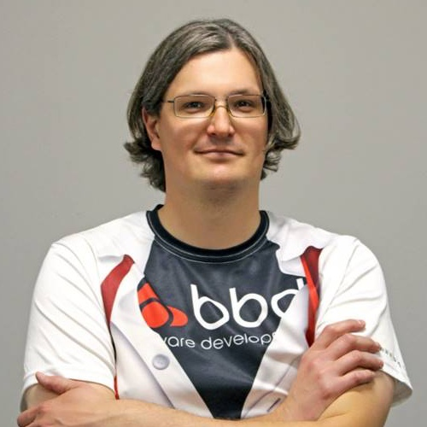

Sorry!
@mikegeyser

Slide 3

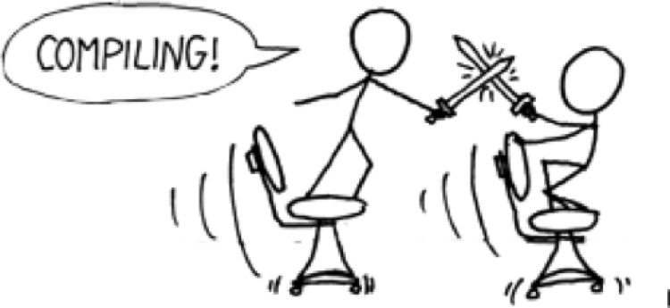
@mikegeyser

Slide 4

@mikegeyser

Slide 5
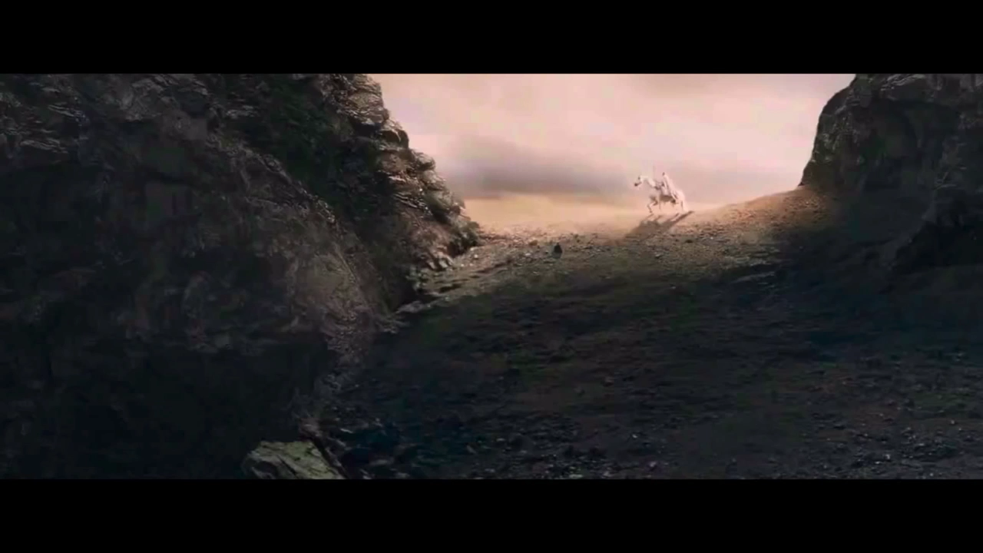

Slide 6
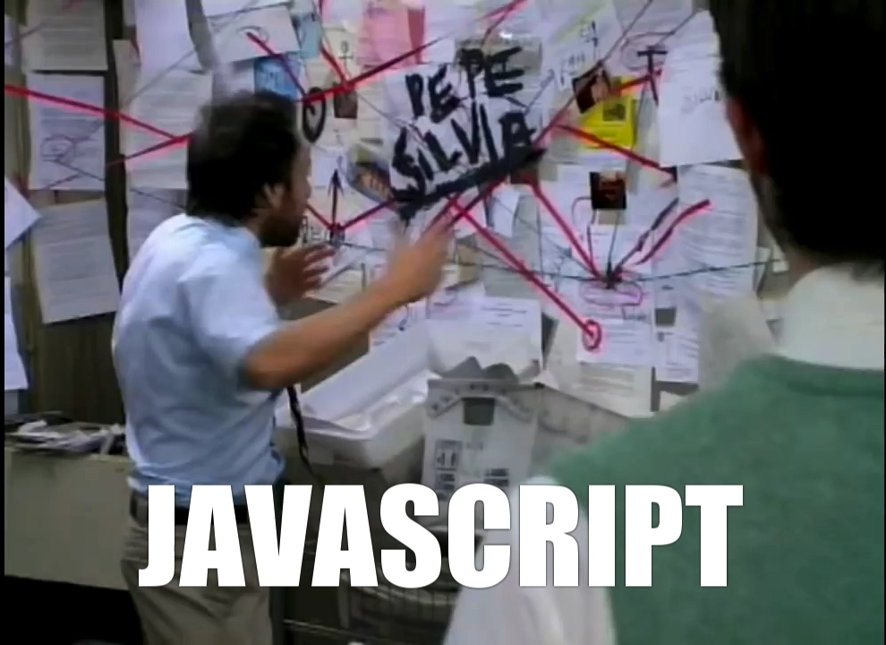

Slide 7
@mikegeyser

Slide 8
@mikegeyser

Slide 9



Service Workers
@mikegeyser

Slide 10
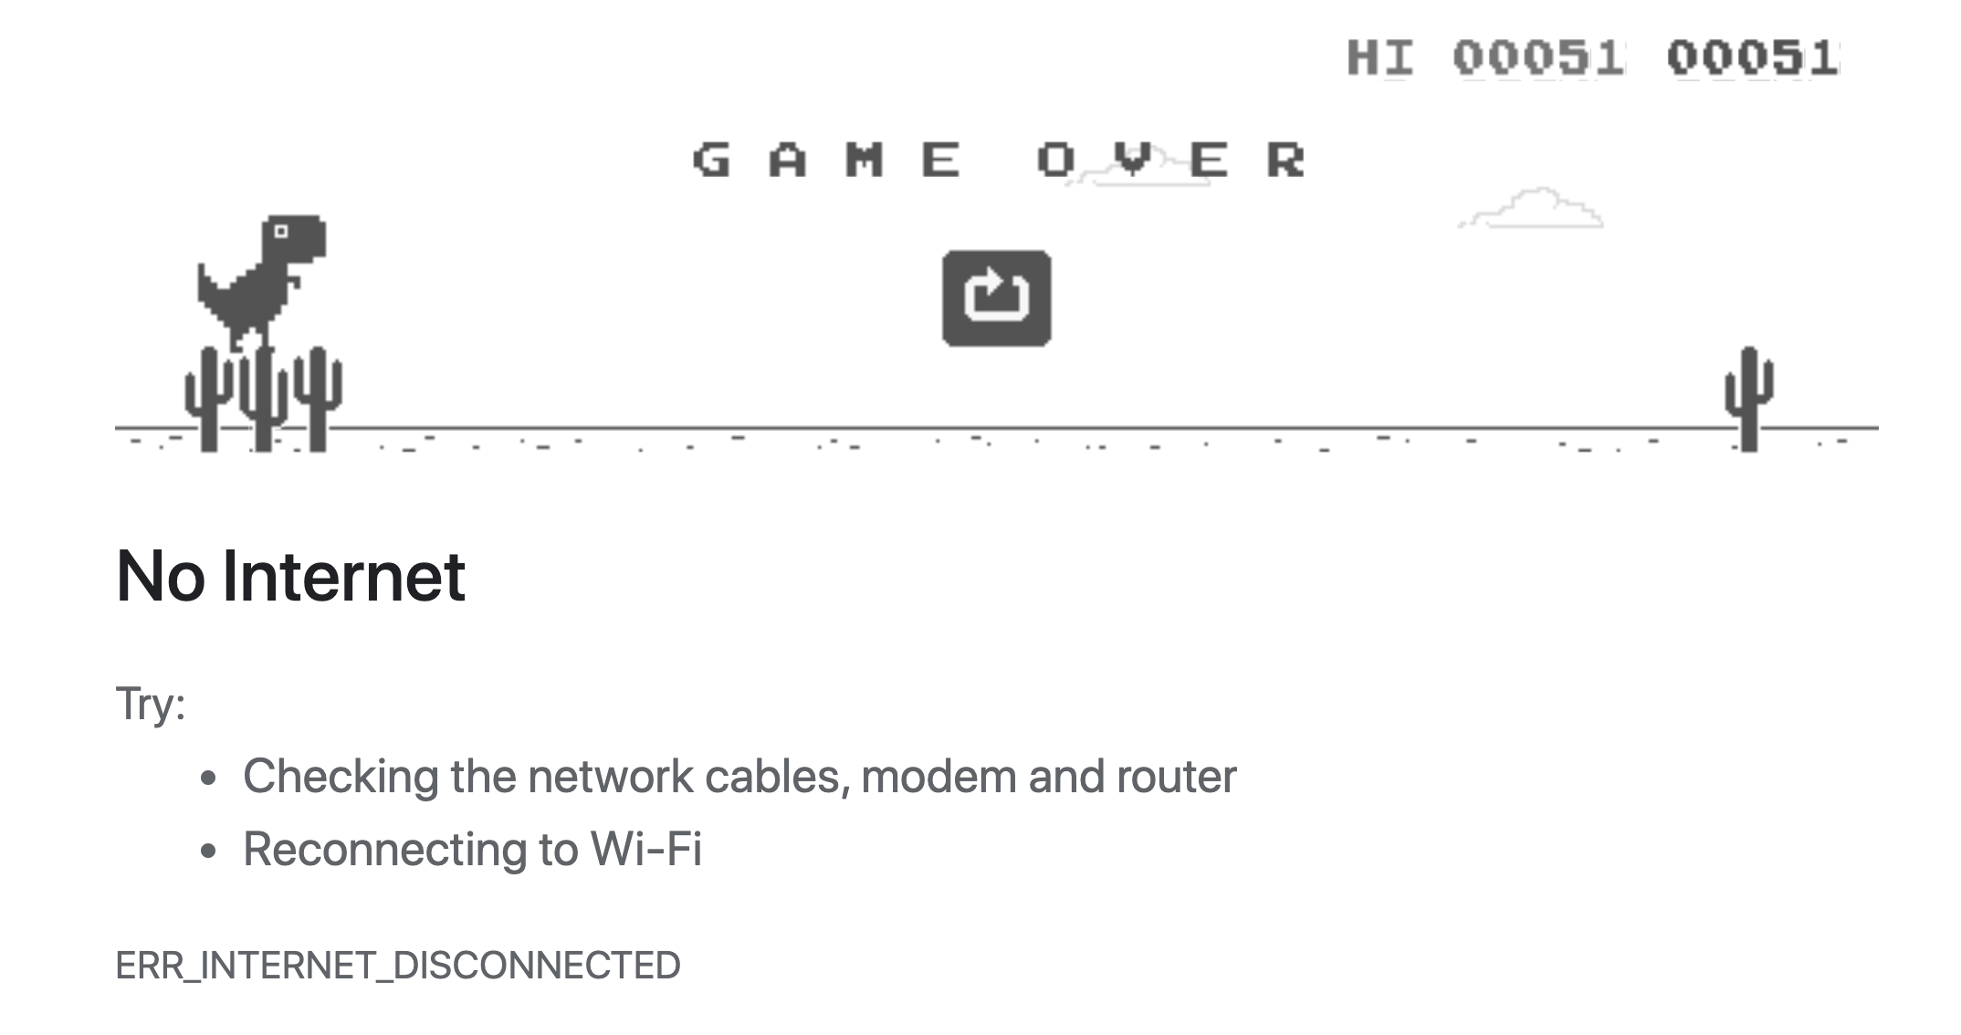

Slide 11

@mikegeyser

Slide 12
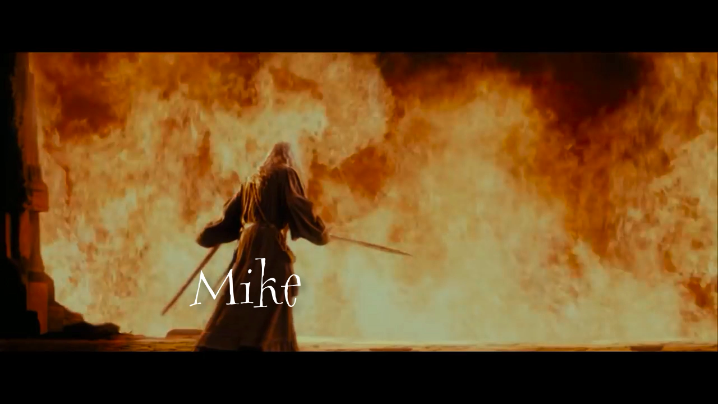

Slide 13
In Summary
Capabilities
Expectations
Thoughtful design
Plan for offline
@mikegeyser

Slide 14





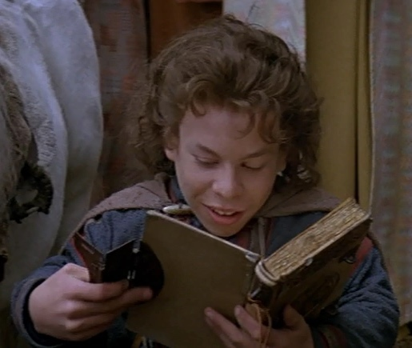
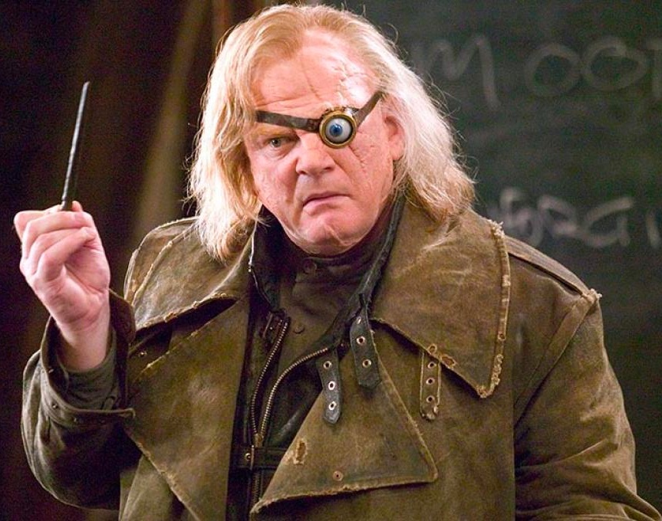
Wizzards
Questions?
@mikegeyser
mikerambl.es/videos
workboxjs.org

